Slide 1
Nalu Homework #1 (Hn01), Task 1 of 2
Task 1: Run Nalu/reg_tests/test_files/dgNonConformalThreeBlade
Modify the input file to increase termination_step_count to ~500.
Visualize the flow field with displacements activated and provide a single image at the final step count.
How does modification of the blade rotation (omega) affect the time step?
Report any modifications that resulted in catastrophic behavior, i.e., the simulation diverged. Document how you caused the simulation to diverge.
See the next page (page 2) for a submission script example
Notes:
If the /mesh directory is empty: Nalu/reg_tests/mesh, then you will need to download the mesh files from: https://github.com/NaluCFD/NaluMesh
Make sure that the paths to the xml and mesh file are modified. This input file was designed to be run within the regression test environment and not as a stand-alone case. You may copy over the file(s) or specify a direct path:
muelu_xml_file_name: /shared/nalu/build/Nalu/reg_tests/xml/milestone.xml
mesh: /shared/nalu/build/Nalu/reg_tests/mesh/threeBladeMesh.g

Slide 2
Example Submission Script: one node, 16 cores
#!/bin/bash
#SBATCH -J test # Job name
#SBATCH -o job.%j.out # Name of stdout output file (%j expands to jobId)
#SBATCH -N 1 # Total number of nodes requested
#SBATCH -n 16 # Total number of mpi tasks requested
#SBATCH -t 00:15:00 # Run time (hh:mm:ss)
PROG=" /shared/nalu/build/Nalu/build/naluX"
ARGS="-i dgNonConformalThreeBlade.i -o output.log"
### ---------------------------------------
### BEGINNING OF EXECUTION
### ---------------------------------------
mpiexec $PROG $ARGS

Slide 3
Nalu Homework #1 (Hn01), Task 2 of 2
Task 2: Run Nalu/reg_tests/test_files/fluidsPmrChtPeriodic
Modify the input file to increase termination_step_count to ~500.
Visualize the temperature, velocity, and radiative file (your choice) and provide a single image at the final step count.
Modify the gravity constant such that the Rayleigh number 10x, 100x, etc. Report any findings; does the code benefit from a modification of initial time step size?
What happens if you change the velocity hybrid parameter to: velocity: 0.0
Notes:
If the /mesh directory is empty: Nalu/reg_tests/mesh, then you will need to download the mesh files from: https://github.com/NaluCFD/NaluMesh
Make sure that the paths to the xml and mesh file are modified as with task #1

Slide 4
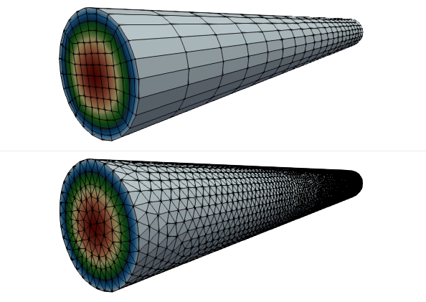
Nalu Homework #1 (Hn01), Optional: Specified Pressure Drop Laminar Pipe Flow:
Location: https://github.com/spdomin/Present/tree/master/stanfordMe469/hw/one
You will modify the input file to provide the density, viscosity and pressure drop to achieve Re^{τ} = 10 and report on the differences between the simulation and analytical centerline velocity.
Specifications:
Re^{τ} = 10
Pipe diameter, D = 0.01 m
Pipe Length, L = 0.1 m
Perform a global momentum balance to determine the pressure gradient. dp/dz as a function of the wall shear stress , τ_{w}.
Given Re^{τ} = ρ u^{τ} D / μ and τ_{w} = ρ (u^{τ})², where u^{τ} is the wall friction velocity, report the required pressure gradient required for the desired Re^{τ} = 10.
Modify the input file to specify the proper density, viscosity and open pressure specification (look for the pressure specification under open_user_data).
Run both the Hex8 and Tet4 input file and compare the simulation centerline velocity to the analytical result (feel free to derive or simply report the functional form).
Capture any findings between the Hex8 and Tet4 simulation, e.g., simulation time, velocity component qualitative differences, convergence, etc.

